Slide 1

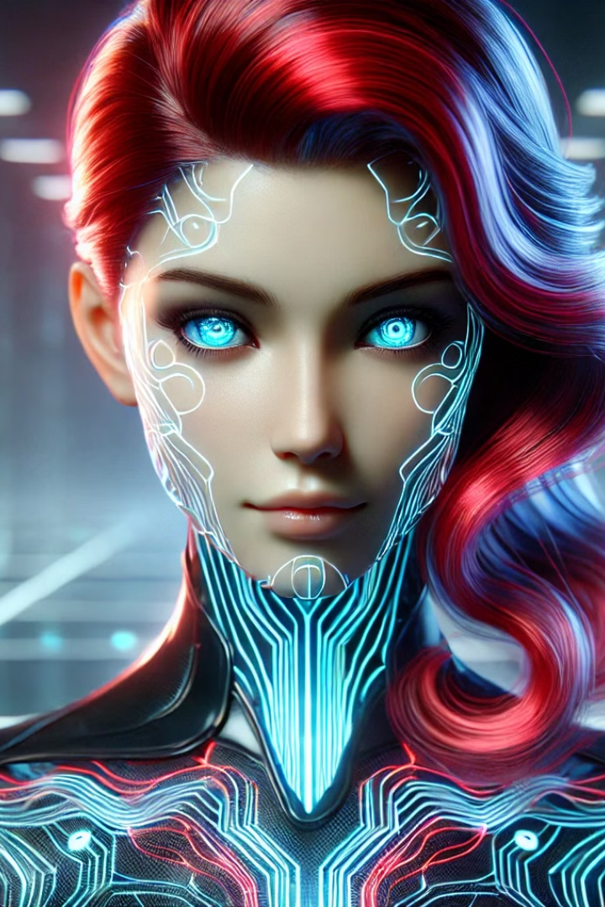
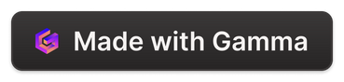
Introducing Natasha: Your Virtual AI Assistant
Welcome! Today we'll explore the capabilities, applications, and impact of Natasha, a cutting-edge virtual assistant powered by AI. Natasha is designed to enhance productivity, efficiency, and the overall user experience.
Minor Project
Nikhil Shukla
MCA – ll(B)
ABES Engineering College
Notes:
1

Slide 2

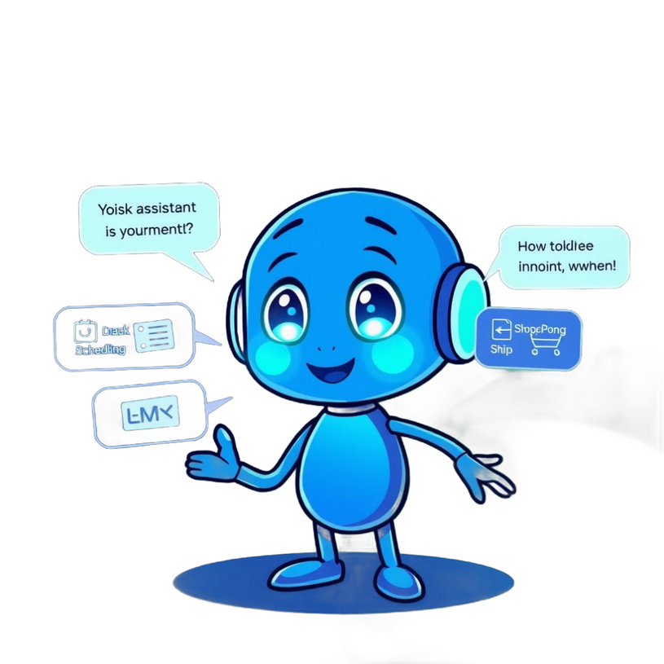
Objective of the project :
The development of technology allows introducing more advanced solutions in everyday life. This makes work less exhausting for employees, and also increases the work safety. As the technology is developing day by day people are becoming more dependent on it, one of the mostly used platform is computer. We all want to make the use of these computers more comfortable, traditional way to give a command to the computer is through keyboard but a more convenient way is to input the command through voice. Giving input through voice is not only beneficial for the normal people but also for those who are visually impaired who are not able to give the input by using a keyboard. For this purpose, there is a need of a virtual assistant which can not only take command through voice but also execute the desired instructions and give output either in the form of voice or any other means.
A Virtual Assistant is the software that can perform task and provide different services to the individual as per the individual's dictated commands. This is done through a synchronous process involving recognition of speech patterns and then, responding via synthetic speech. Through these assistants a user can automate tasks ranging from but not limited to mailing, tasks management and media playback. It understands natural language voice commands and complete the tasks for the user. It is typically a cloud-based program that requires internet connected devices and/or applications to work. The technologies that power virtual assistants are machine learning, natural language processing and speech recognition.
Notes:
2

Slide 3
Natasha's Capabilities: Leveraging Features of Natasha
Natural Language Processing
Personalized Recommendations
Contextual Awareness
Multi-Platform Integration
Natasha understands and responds to natural language, making interactions seamless and intuitive.
Natasha learns your preferences and provides tailored suggestions for tasks and information.
Natasha remembers past interactions, ensuring a personalized and efficient experience.
Natasha seamlessly integrates with your devices and apps, making it a truly universal assistant.
Notes:
3

Slide 4





Seamless Integration: Harnessing the Power of AI
Calendar Management
Email Automation
Online Shopping
Entertainment
Schedule meetings, set reminders, and manage your time efficiently with Natasha.
Compose emails, send personalized messages, and organize your inbox with Natasha.
Find products, compare prices, and make purchases with Natasha.
Discover new music, find movies, and control your smart home devices with Natasha.
Notes:
4

Slide 5
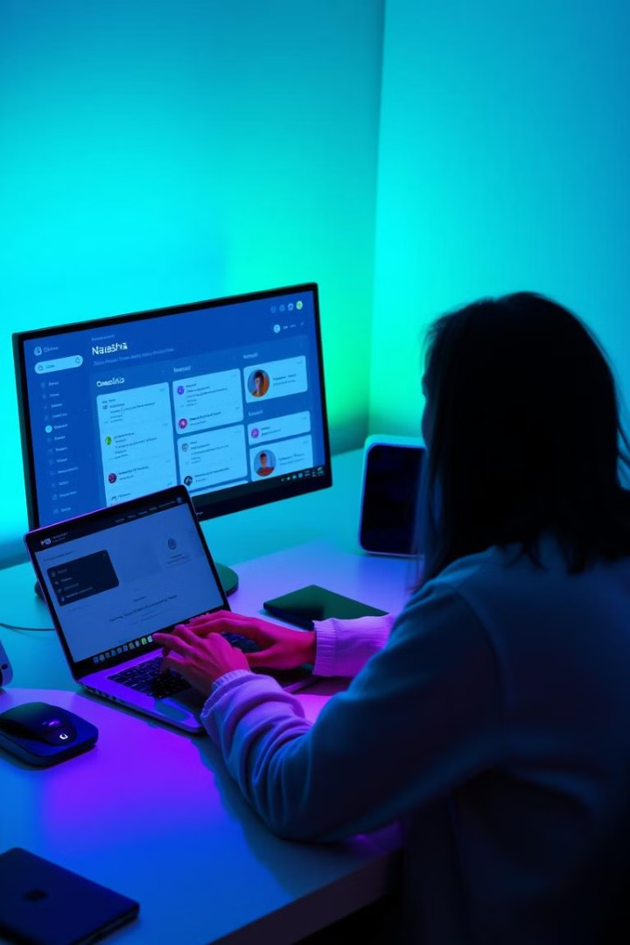
Practical Applications: Enhancing Productivity and Efficiency
Task Management
Research Assistance
Create to-do lists, set priorities, and track progress with Natasha.
Gather information, search the web, and find relevant resources with Natasha.
Language Translation
Data Analysis
Break down language barriers and communicate effectively with Natasha.
Analyze data, generate reports, and gain insights with Natasha.
Notes:
5

Slide 6





Future Scope: Revolutionizing the Computer Science Field
Personalization
1
Natasha will become even more tailored to individual needs and preferences.
2
Emotional Intelligence
Natasha will be able to understand and respond to human emotions.
3
Predictive Analytics
Natasha will anticipate needs and provide proactive solutions.
4
Human-AI Collaboration
Natasha will work alongside humans, enhancing their capabilities.
5
Ethical Considerations
Natasha's development will prioritize ethical principles and responsible AI.
Notes:
6

Slide 7
Natasha's Impact: Transforming Human Life
1
Time Savings
Natasha automates tasks, freeing up time for more important activities.
2
Increased Efficiency
Natasha streamlines processes, making work and life more productive.
3
Enhanced Communication
Natasha facilitates clear and effective communication across language barriers.
Improved Access to Information
4
Natasha provides quick and accurate access to information, fostering knowledge.
Notes:
7

Slide 8

Conclusion: Embracing the AI-Driven Future
Natasha is a testament to the incredible potential of AI to transform our lives. By embracing AI and harnessing its power, we can create a future where technology empowers us to achieve greater things. Thank you for your time!
Notes:
8

